Slide 1

Body Language
Kaiqi Wang

Slide 2
CONTENT
1
What
2
Why
3
How

Slide 3
1
What
What is body language

Slide 4
1
What
Body language
Facial expressions
Body posture
Gestures
Eye movement
Notes:
Body language is a type of non-verbal communication in which physical behavior. Such behavior includes facial expressions, body posture, gestures, eye movement and so on.

Slide 5
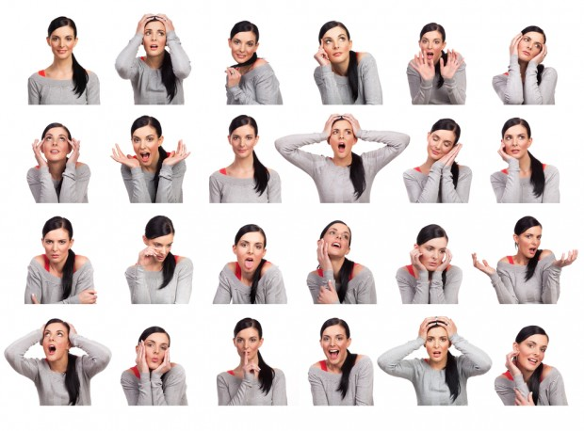
1
What
Notes:
Through body language, we can see whether you are happy or sad, whether you are confident or nervous.

Slide 6
2
Why
Why body language is important when presenting

Slide 7
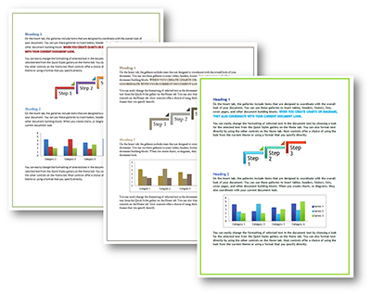



2
Why
Content
Visuals
Speaker’s actions
Notes:
The audience get a speaker’s message through the content, visuals and the speaker’s actions.

Slide 8
2
Why
What you do
What you say
Notes:
When you present, what you do with your body is as important as what you say. Your body language helps to show the audience that you are well prepared, confident and care about the topic.

Slide 9
3
How
How to use body language when presenting

Slide 10
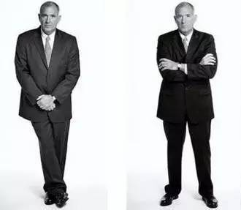
3
How
Notes:
These are wrong gestures. Crossing your hands or arms looks bad. It seems that you are lack of confidence and nervous.

Slide 11
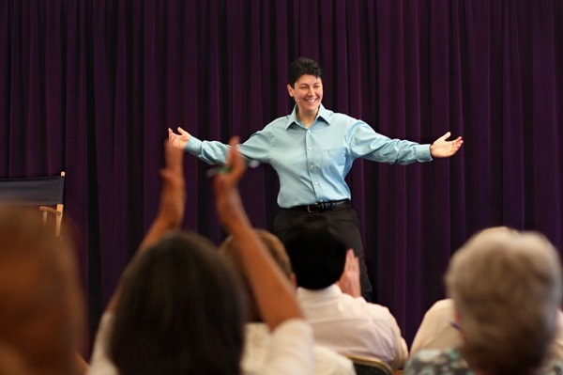
3
How
Notes:
However, if you keep your hands by your side of elbows loose, you will look open and relaxed. It will also make audience relaxed and give audience impressive impression.

Slide 12
Thank you!

